Slide 1


How to resolve issues from hybird system upgrade?
By Richard Jiang
The future is present -----Mobile Team

Slide 2


Slide 3

IOS Platform

Slide 4


HTTPS
Note: The service must be support https for IOS 9+, IOS 10, also support IPV6.

Slide 5
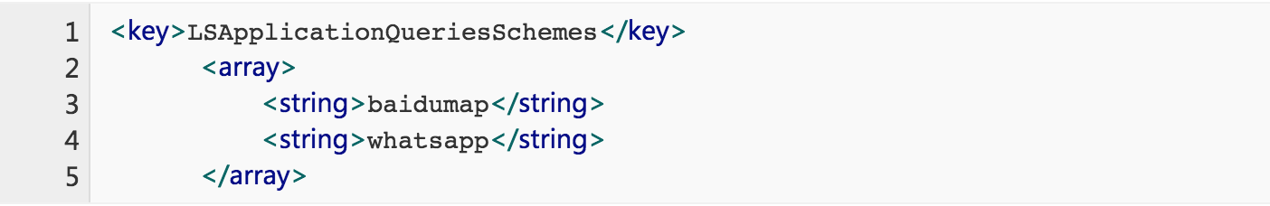
Configure Whitelist For External App
Eg. Pay for Alipay, weixin pay, share information by qq, weixin, weibo.

Slide 6
Configure Whitelist For External App
Eg. Pay for Alipay, weixin pay, share information by qq, weixin, weibo.

Slide 7
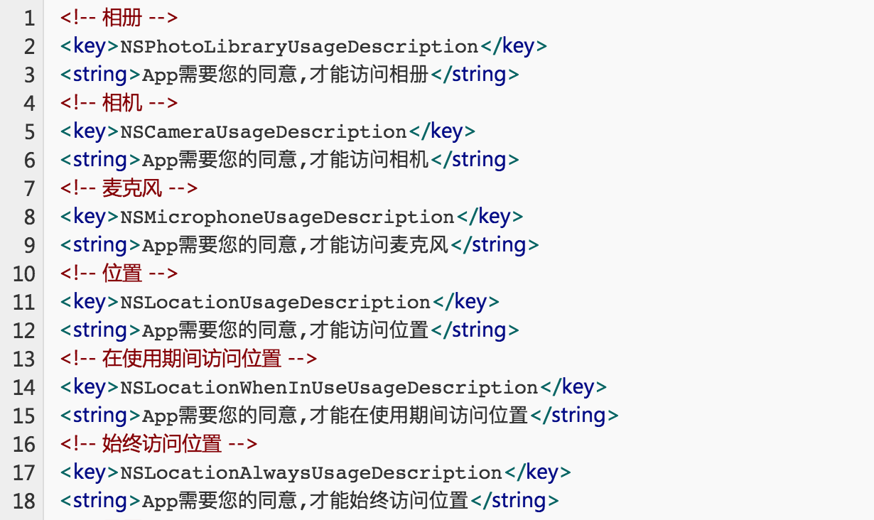
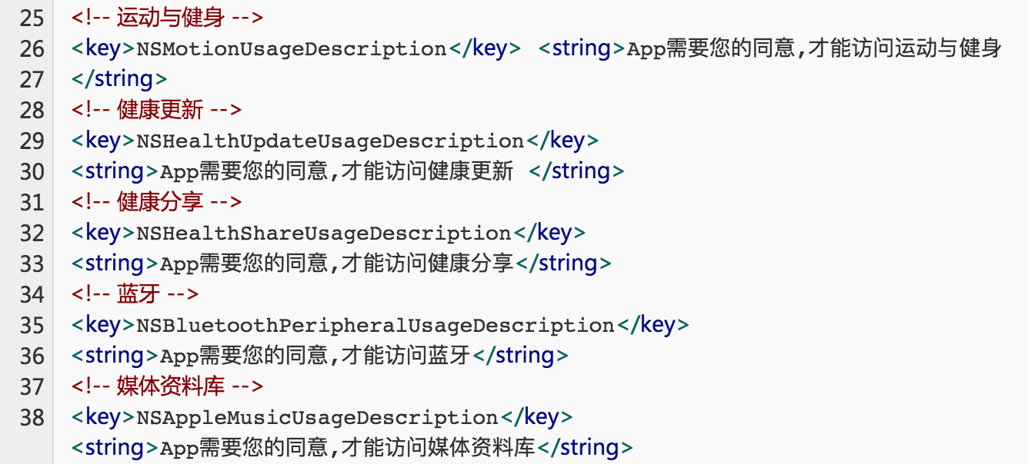
Configure Description For Camera…
Note： we must configure the description for some functions. It is necessary for ios10+.

Slide 8
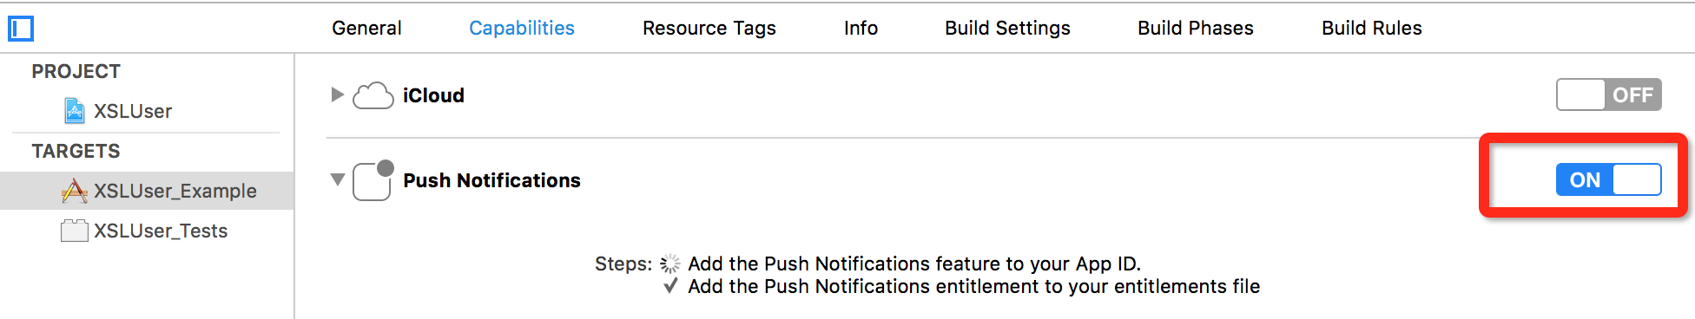
Notification On IOS 10+
Note：Open Notification function on Xcode 8.

Slide 9
Android Platform

Slide 10
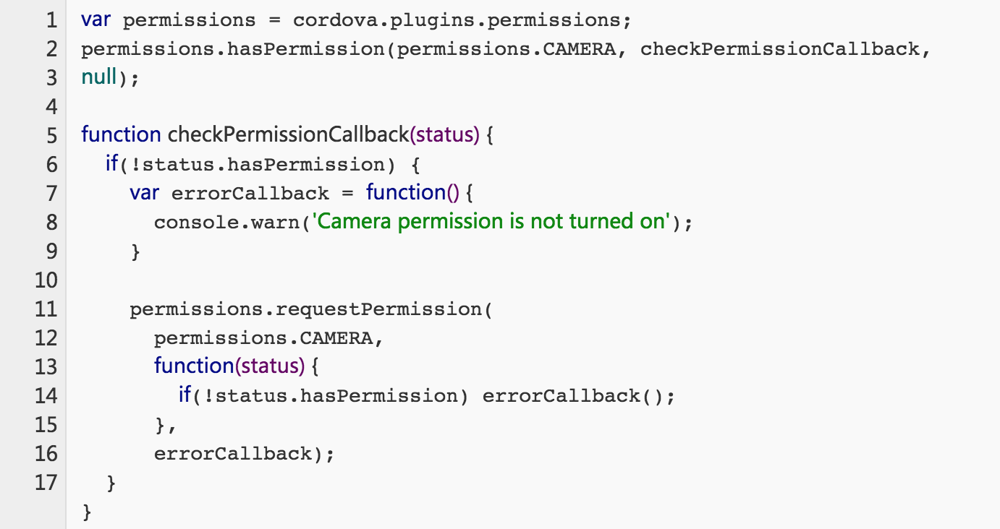
Request Permissions

Slide 11
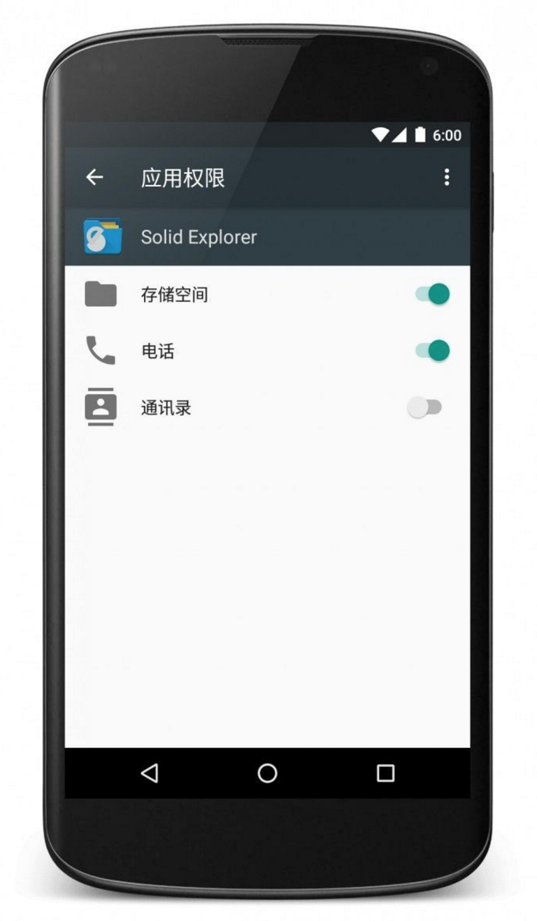
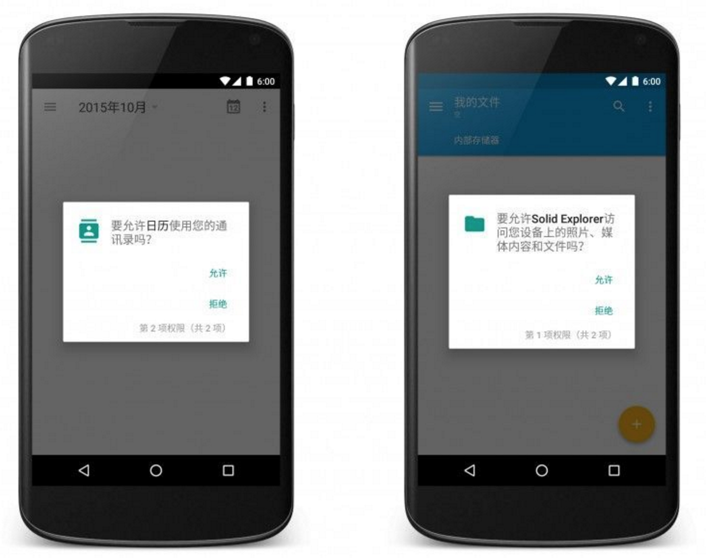

Slide 12
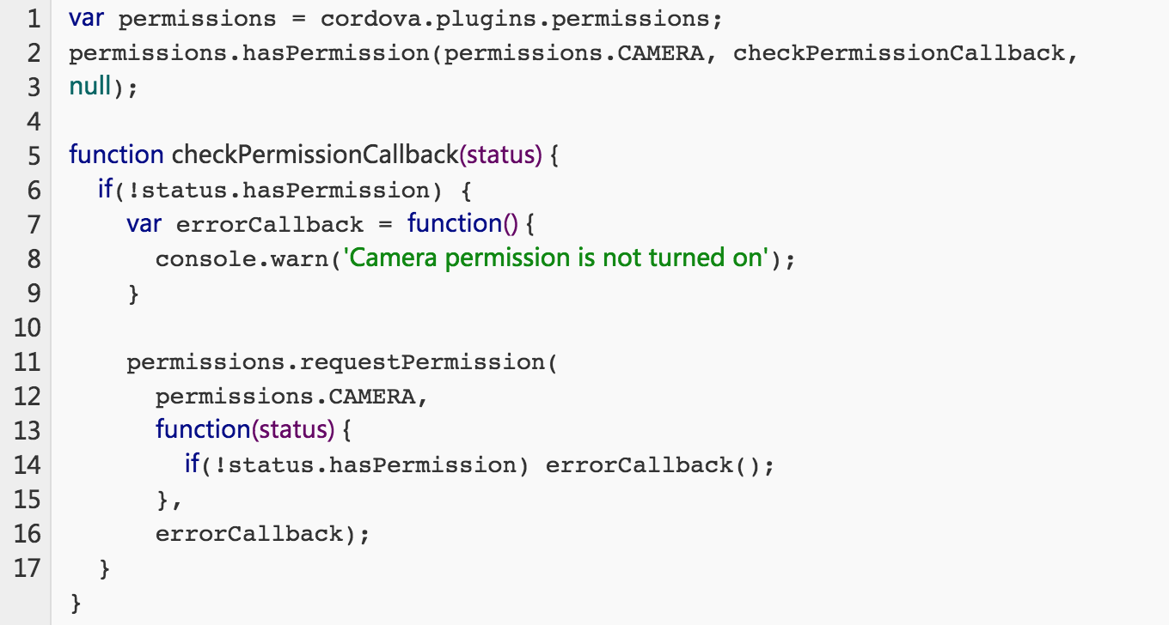
Request Permissions For Hybird

Slide 13
Cordova

Slide 14
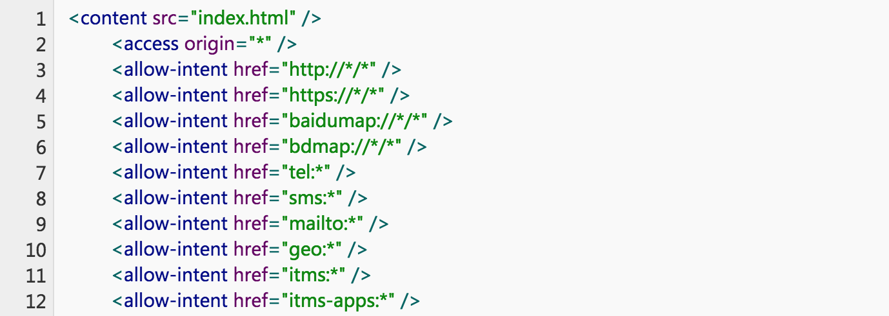
Configure allow-intent
Eg： <a href="tel:2342345" />

Slide 15
Stable Plugin
Note: @latest is new, but it is not stable, otherwise it will be stable.

Slide 16
Monitor the Memory Used

Slide 17
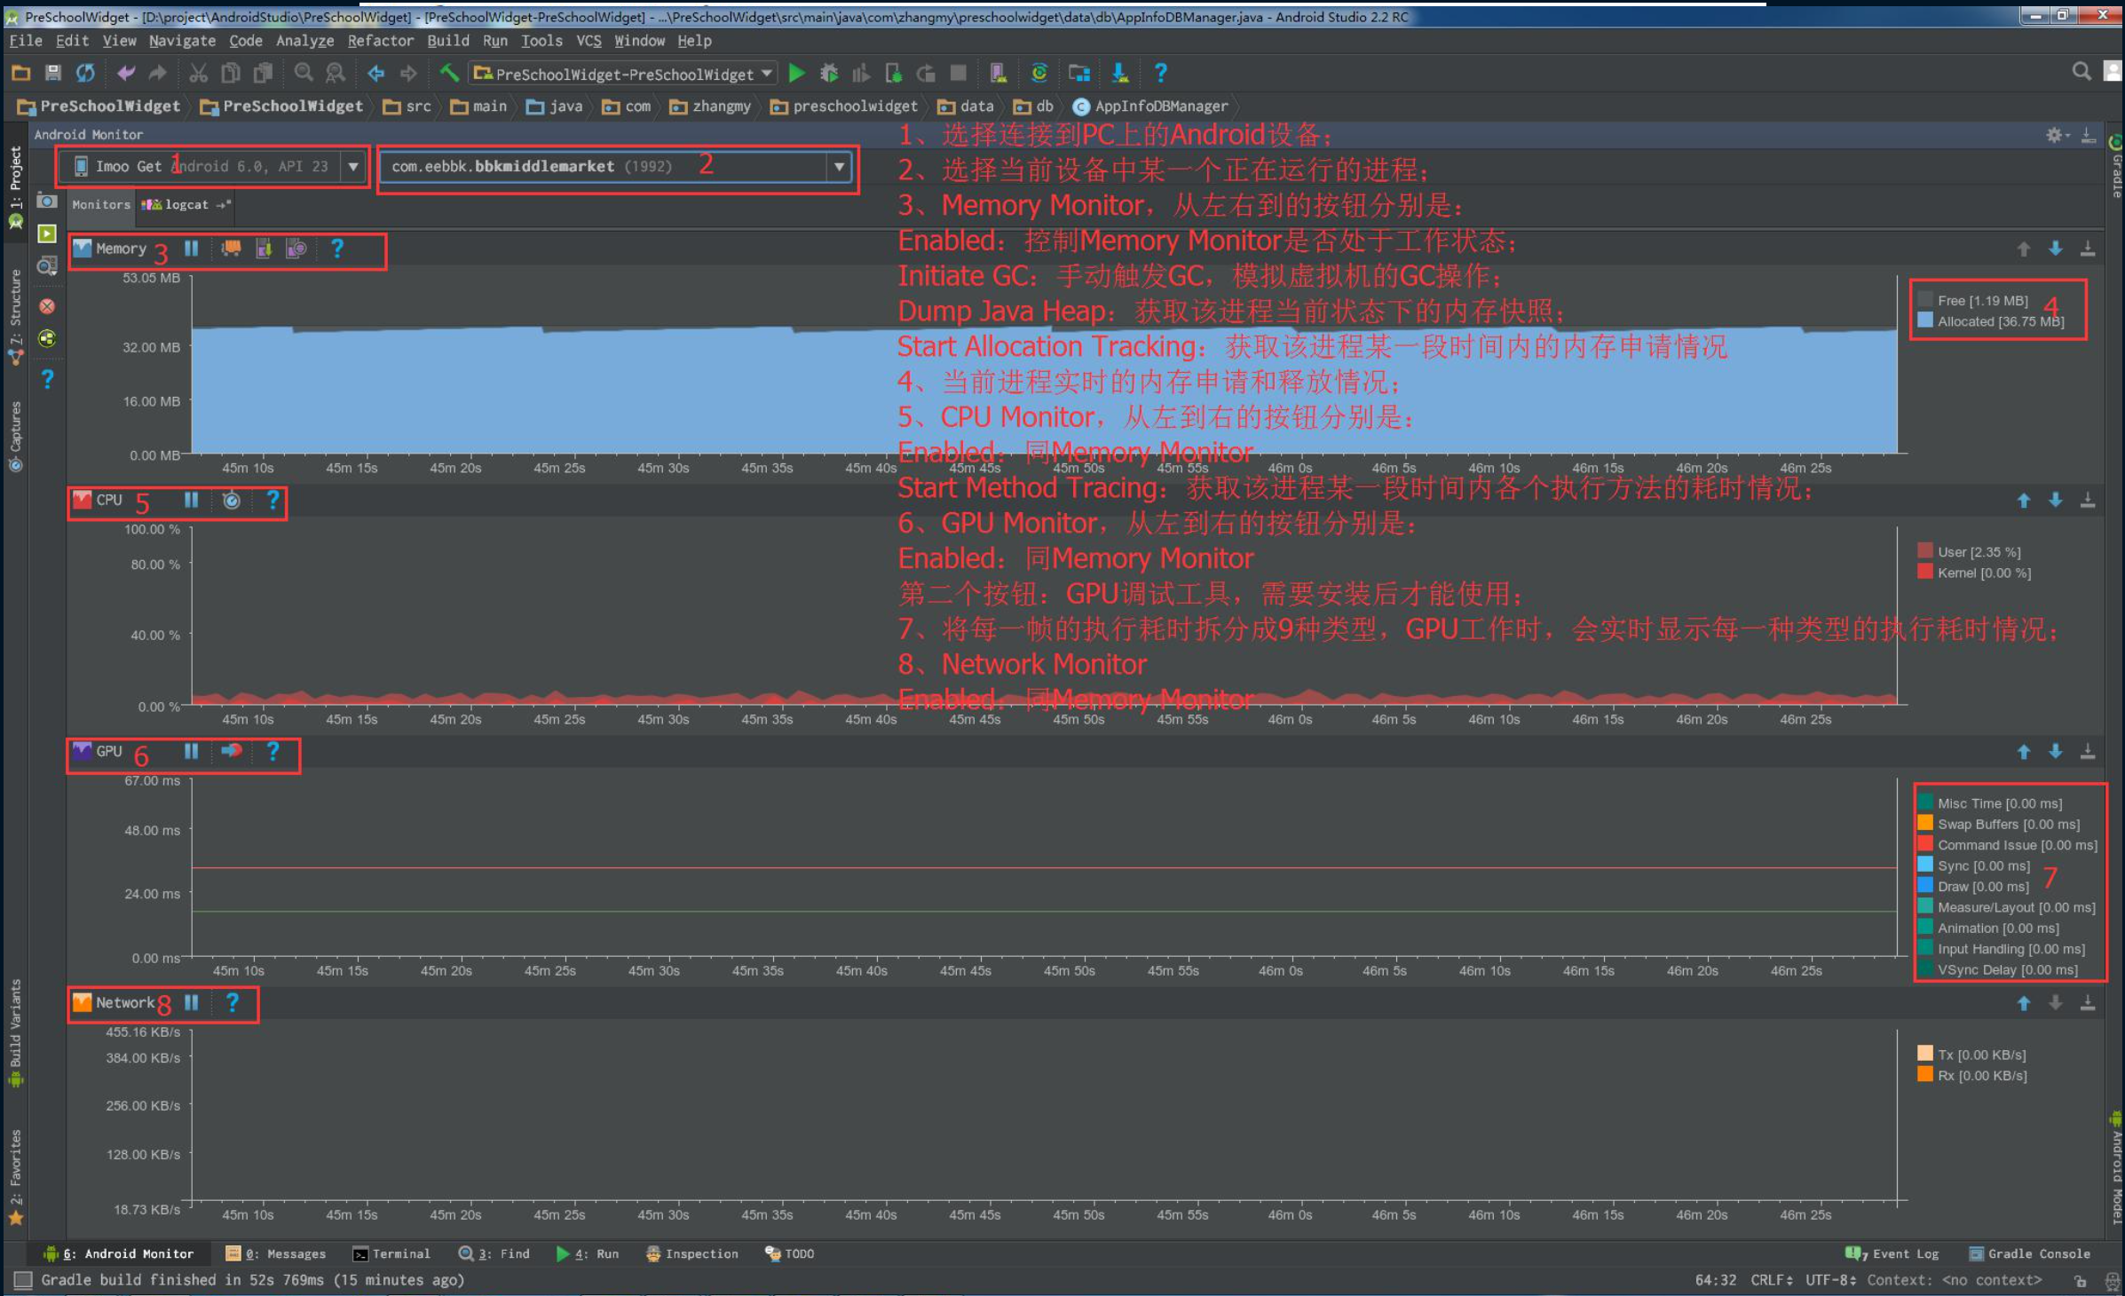

Slide 18
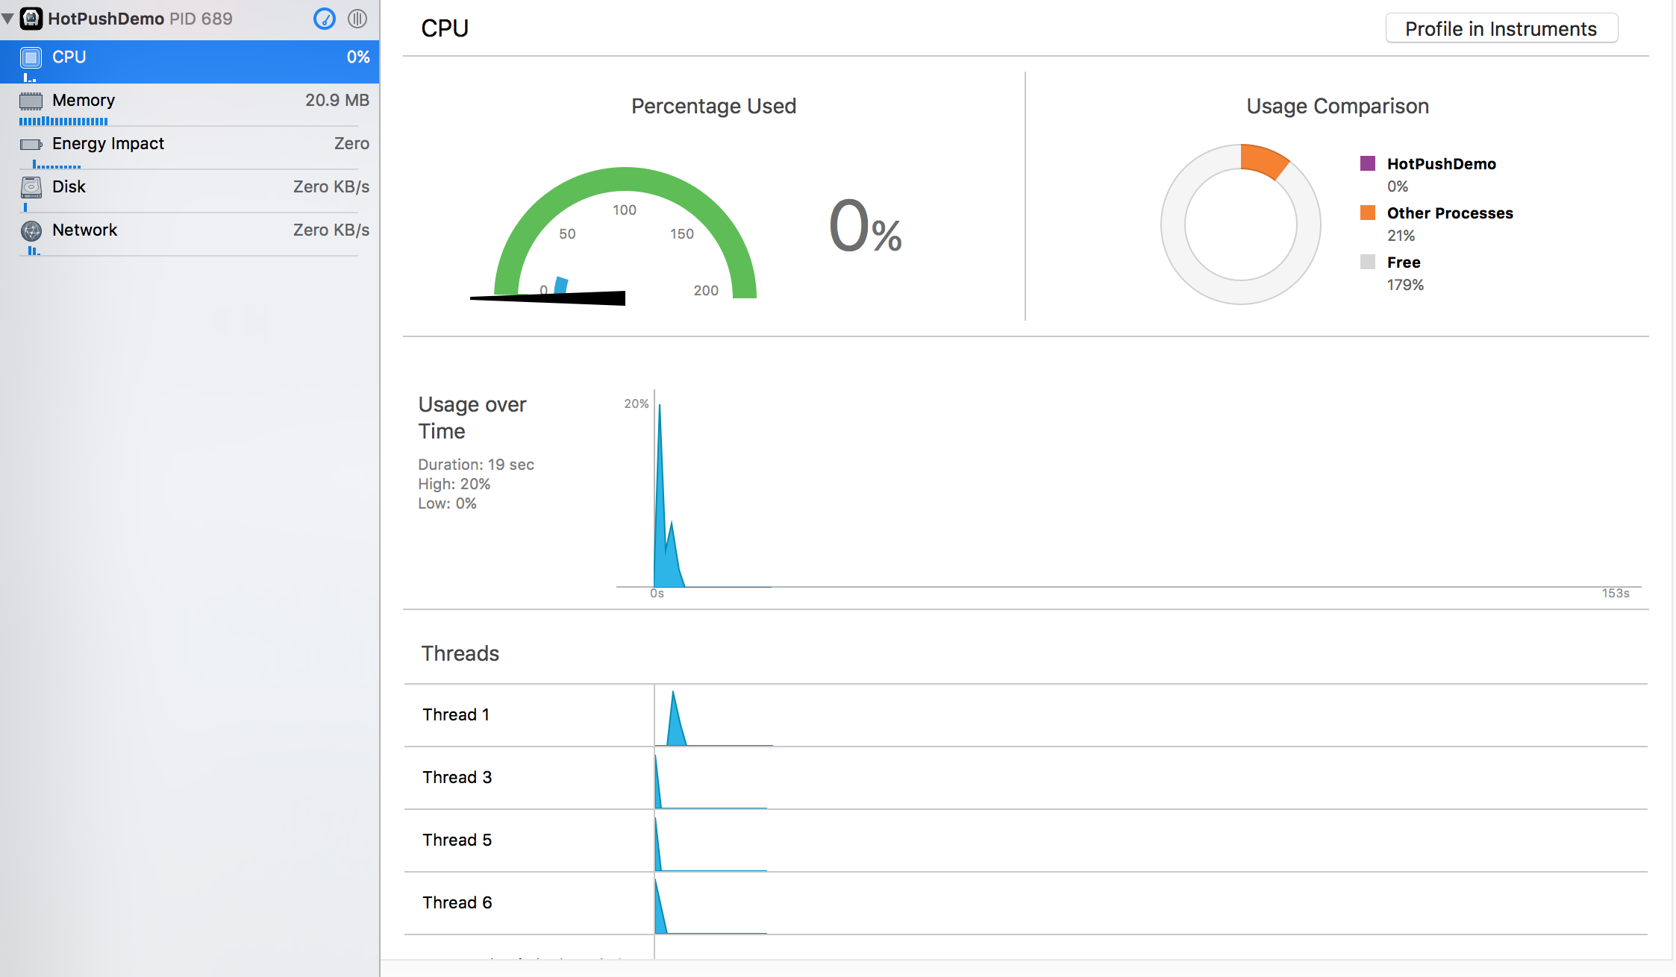

Slide 19


